Slide 1
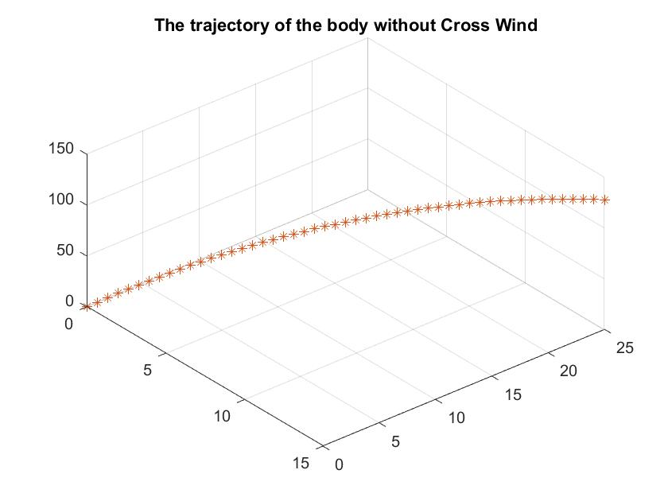

Slide 2
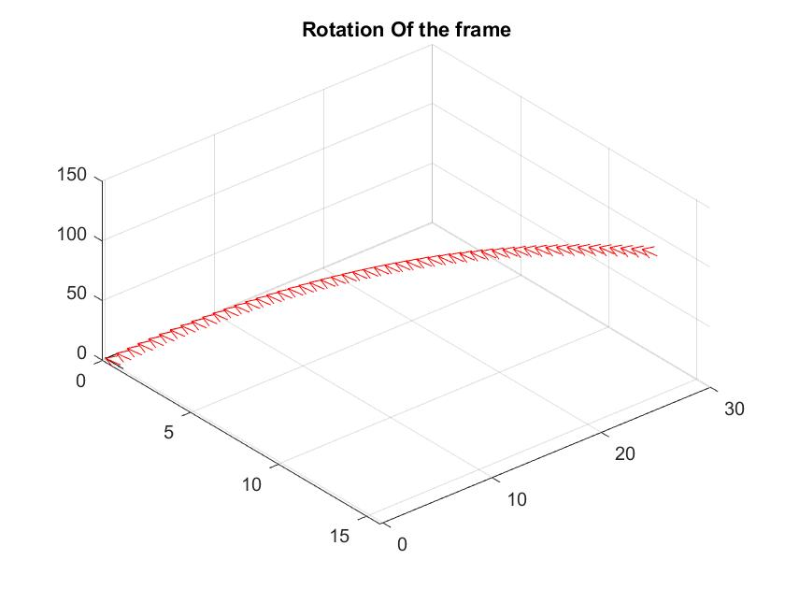
With moment M=[0;0;2]

Slide 3
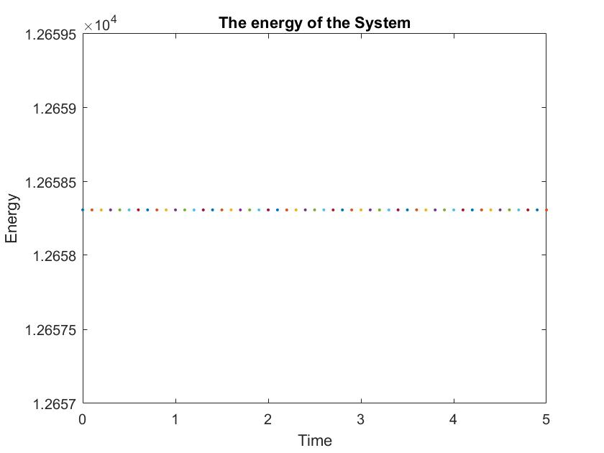
The energy of the system with moment M=[0;0;0]

Slide 4
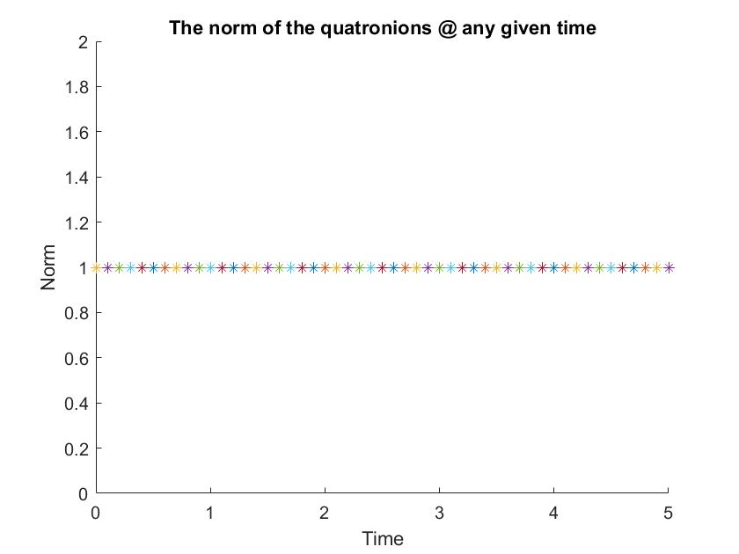
The Norm of the quaternions given by ODE45 was 1.

Slide 5
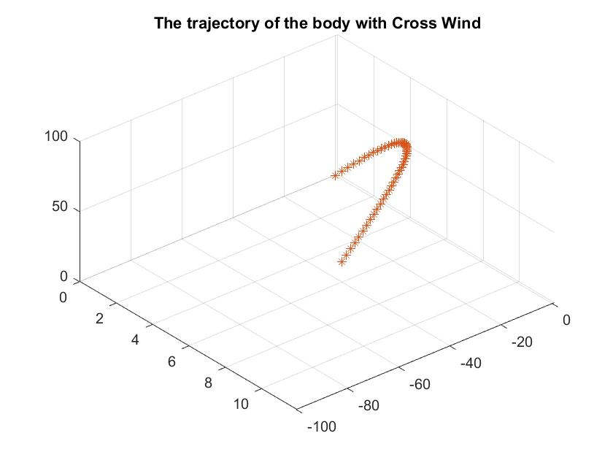
With the crosswind of flowrate=[0;-100;0];

Slide 6
